Slide 1
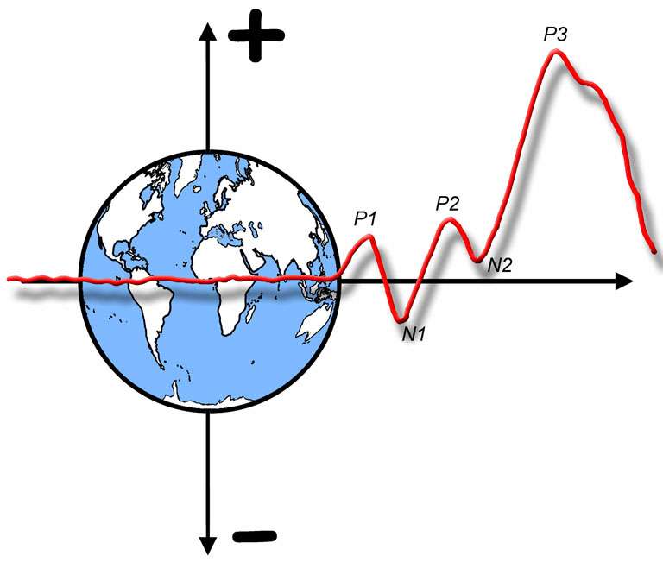

The ERP Boot Camp
Filtering and Linear Systems Analysis

Slide 2
Filtering Overview
Filter- To remove some components of an input and pass others
We will concentrate on Finite Impulse Response (FIR) filters
Different approaches to filtering
Hardware filters
Filtering by conversion to frequency domain
Filtering by computing weighted average of adjacent points
Filtering by convolving with impulse response function
These are all mathematically equivalent
Relatively simple relationships between them
By understanding these relationships, you will have a much deeper understanding of the nature of ERPs
But this stuff can blow your mind…
Notes:
© S. J. Luck. All Rights Reserved. May be used for nonprofit educational purposes if this copyright notice is included. Permission must be obtained from the copyright holder(s) for any other use.

Slide 3
Fourier Analysis
Time Domain
Frequency Domain
Fourier Transform
Amplitude (or Power)
Inverse Fourier Transform
(Phase, too!)
Any waveform is equivalent to the sum of a set of sine waves of different frequencies, amplitudes and phases
Time domain: Amplitude as a function of time
Frequency domain: Amplitude and phase as a function of frequency
Fourier transform converts time domain to frequency domain
Inverse Fourier transform converts frequency domain to time domain
Notes:
© S. J. Luck. All Rights Reserved. May be used for nonprofit educational purposes if this copyright notice is included. Permission must be obtained from the copyright holder(s) for any other use.

Slide 4
Fourier Analysis
Square wave at F Hz
Amplitude
Time
Fourier transform of square wave at F Hz
Amplitude
+ 9F + 11F + 13F …
Frequency
Notes:
Adapted from Figure 7.2 in Luck, S.J. (2014). An Introduction to the Event-Related Potential Technique, Second Edition. Cambridge, MA: MIT Press. © MIT Press.
This material may be used for nonprofit research and education purposes only, and it may not be reprinted or distributed in any form including print and electronic forms.

Slide 5
Fourier Analysis
Notes:
Adapted from Figure 7.2 in Luck, S.J. (2014). An Introduction to the Event-Related Potential Technique, Second Edition. Cambridge, MA: MIT Press. © MIT Press.
This material may be used for nonprofit research and education purposes only, and it may not be reprinted or distributed in any form including print and electronic forms.

Slide 6
Phase and the “Imaginary” Component
If you add a sine wave and a cosine wave of the same frequency, you get a sinusoid of the same frequency but a different amplitude and phase
Two different ways to characterize a sinusoid of a given frequency:
Phase and Amplitude
Sine Component and Cosine Component
Amplitude = sqrt(sine² + cosine²)
Phase = arctan(cosine/sine)
Notes:
Adapted from Figure S7.1 in Luck, S.J. (2014). An Introduction to the Event-Related Potential Technique, Second Edition. Cambridge, MA: MIT Press. © MIT Press.
This material may be used for nonprofit research and education purposes only, and it may not be reprinted or distributed in any form including print and electronic forms.

Slide 7
Phase and the “Imaginary” Component
If you add a sine wave and a cosine wave of the same frequency, you get a sinusoid of the same frequency but a different amplitude and phase
Two different ways to characterize a sinusoid of a given frequency:
Phase and Amplitude
Sine Component and Cosine Component
Amplitude = sqrt(sine² + cosine²)
Phase = arctan(cosine/sine)
Notes:
Adapted from Figure S7.1 in Luck, S.J. (2014). An Introduction to the Event-Related Potential Technique, Second Edition. Cambridge, MA: MIT Press. © MIT Press.
This material may be used for nonprofit research and education purposes only, and it may not be reprinted or distributed in any form including print and electronic forms.

Slide 8
Fundamental Principle #1
Power at a frequency in a Fourier transform does not mean that an oscillation was present at that frequency
What the #$%$#&@?!!!
Then what does power at a frequency mean?
Power at a frequency means that a sine wave at that frequency, when added to other sine waves at other frequencies, can create an equivalent waveform
It does not mean that the biological signal consists of the sum of these sine waves
Notes:
© S. J. Luck. All Rights Reserved. May be used for nonprofit educational purposes if this copyright notice is included. Permission must be obtained from the copyright holder(s) for any other use.

Slide 9

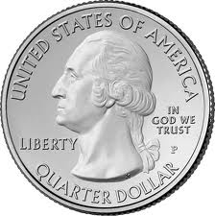
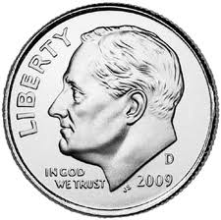
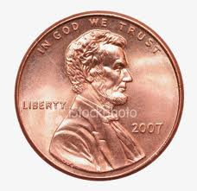
Analogy: Money
A $1 bill is equal in value to 4 quarters
It is not made of 4 quarters!
It can be exchanged for 4 quarters
It can also be exchanged for 9 dimes + 10 pennies
Notes:
© S. J. Luck. All Rights Reserved. May be used for nonprofit educational purposes if this copyright notice is included. Permission must be obtained from the copyright holder(s) for any other use.

Slide 10
Analogy: Square Waves
The square waves do not actually consist of the sum of the sine waves
Notes:
Adapted from Figure 7.2 in Luck, S.J. (2014). An Introduction to the Event-Related Potential Technique, Second Edition. Cambridge, MA: MIT Press. © MIT Press.
This material may be used for nonprofit research and education purposes only, and it may not be reprinted or distributed in any form including print and electronic forms.

Slide 11
Basis Functions
In mathematics, there are many sets of “basis functions” that can be used to recreate a given set of data
Sine waves
Polynomials (X⁰, X¹, X², X³, …)
Spline functions
PCA
ICA
Any waveform can be reconstructed in any of these ways, and there is no underlying “truth” to the reconstructions
Notes:
© S. J. Luck. All Rights Reserved. May be used for nonprofit educational purposes if this copyright notice is included. Permission must be obtained from the copyright holder(s) for any other use.

Slide 12
Nonetheless…
Bona fide oscillations are sometimes present
60-Hz line noise
Alpha
Gamma oscillations have been clearly demonstrated in animals
Noise is often largely confined to distinct frequency bands
Skin potentials (almost entirely below 1 Hz)
Muscle noise (almost entirely above 20 Hz)
Time-frequency analyses can reveal brain activity that is invisible in conventional averages
It is still useful to think in terms of the frequency domain, as long as you’re careful
Notes:
© S. J. Luck. All Rights Reserved. May be used for nonprofit educational purposes if this copyright notice is included. Permission must be obtained from the copyright holder(s) for any other use.

Slide 13
Example Low-Pass Filter
Low-pass filters pass low frequencies, attenuate high frequencies
Rolloff (slope): How steeply gain changes as frequency increases
Measured in dB/octave
6 dB = 50% drop in amplitude; 3 dB = 50% drop in power
1 octave = doubling of frequency
Notes:
Adapted from Figure 5.1 from Luck, Steven J. (2005). An introduction to the Event-Related Potential Technique. Cambridge, MA: MIT Press.© MIT Press. This material may be used for nonprofit research and education purposes only, and it may not be reprinted or distributed in any form including print and electronic forms.
Other content: © S. J. Luck. All Rights Reserved. May be used for nonprofit educational purposes if this copyright notice is included. Permission must be obtained from the copyright holder(s) for any other use.

Slide 14
Variations in Cutoff Frequency
Notes:
Adapted from Figure 5.1 from Luck, Steven J. (2005). An introduction to the Event-Related Potential Technique. Cambridge, MA: MIT Press.© MIT Press. This material may be used for nonprofit research and education purposes only, and it may not be reprinted or distributed in any form including print and electronic forms.
Other content: © S. J. Luck. All Rights Reserved. May be used for nonprofit educational purposes if this copyright notice is included. Permission must be obtained from the copyright holder(s) for any other use.

Slide 15
Example High-Pass Filter
High-pass filters pass high frequencies, attenuate low frequencies
Notes:
Figure 5.2 from Luck, Steven J. (2005). An introduction to the Event-Related Potential Technique. Cambridge, MA: MIT Press.© MIT Press. This material may be used for nonprofit research and education purposes only, and it may not be reprinted or distributed in any form including print and electronic forms.
Other content: © S. J. Luck. All Rights Reserved. May be used for nonprofit educational purposes if this copyright notice is included. Permission must be obtained from the copyright holder(s) for any other use.

Slide 16
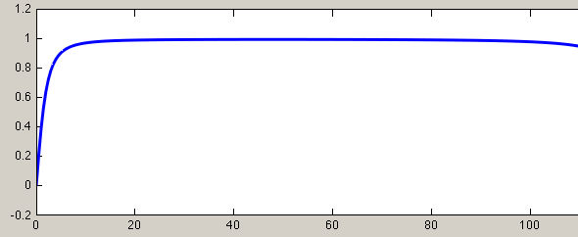
Effect of Cutoff Frequency
High-pass filters cause significant amplitude reduction in slow components (and distortion of fast components) when the cutoff exceeds ~0.1 Hz
Notes:
© S. J. Luck. All Rights Reserved. May be used for nonprofit educational purposes if this copyright notice is included. Permission must be obtained from the copyright holder(s) for any other use.

Slide 17
Why are filters necessary?
Nyquist Theorem
Need to make sure we don’t have frequencies >= 1/2 the sampling rate
Noise reduction
Low-pass filters for muscle noise
High-pass filters for skin potentials
Notch filters for 50/60-Hz line noise
But filters distort your data, so they should be used sparingly
Hansen’s axiom: There is no substitute for clean data
Notes:
© S. J. Luck. All Rights Reserved. May be used for nonprofit educational purposes if this copyright notice is included. Permission must be obtained from the copyright holder(s) for any other use.

Slide 18
Fundamental Principle #2
Precision (spread) in frequency domain is inversely related to precision (spread) in time domain
What is the time domain representation of an infinitesimally narrow spike in frequency domain?
What is the frequency domain representation of an instantaneous impulse in the time domain?
The more you filter, the more temporal precision you lose
The sharper your filter rolloffs, the more temporal precision you lose
The loss of temporal precision can create artifacts that will lead to incorrect conclusions
Notes:
© S. J. Luck. All Rights Reserved. May be used for nonprofit educational purposes if this copyright notice is included. Permission must be obtained from the copyright holder(s) for any other use.

Slide 19
Filtering in Frequency Domain
6 cycles in 100 ms =
60 cycles in 1000 ms
You can use any frequency response function you want
There are also phase shift values for each frequency
Notes:
Adapted from Figure 5.3 in Luck, Steven J. (2005). An introduction to the Event-Related Potential Technique. Cambridge, MA: MIT Press.© MIT Press. This material may be used for nonprofit research and education purposes only, and it may not be reprinted or distributed in any form including print and electronic forms.
Other content: © S. J. Luck. All Rights Reserved. May be used for nonprofit educational purposes if this copyright notice is included. Permission must be obtained from the copyright holder(s) for any other use.

Slide 20
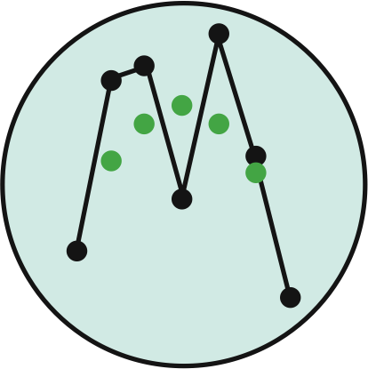
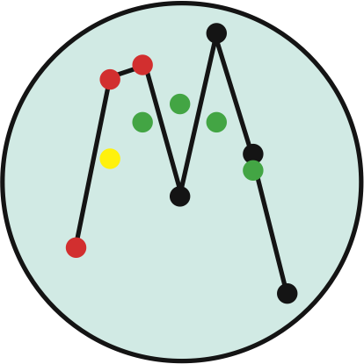
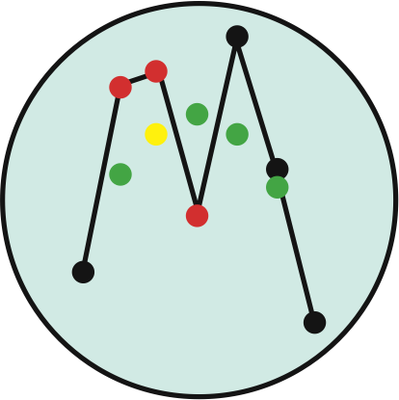
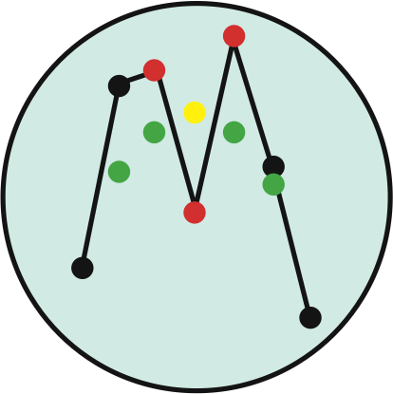
Filtering in Time Domain
Notes:
Adapted from Figure 5.4 in Luck, Steven J. (2005). An introduction to the Event-Related Potential Technique. Cambridge, MA: MIT Press.© MIT Press. This material may be used for nonprofit research and education purposes only, and it may not be reprinted or distributed in any form including print and electronic forms.
Other content: © S. J. Luck. All Rights Reserved. May be used for nonprofit educational purposes if this copyright notice is included. Permission must be obtained from the copyright holder(s) for any other use.

Slide 21
Running-Average Filter
(AKA Boxcar Filter)
Note: Increasing p produces both greater filtering and a reduction in temporal precision
Notes:
Adapted from Figure 5.4 in Luck, Steven J. (2005). An introduction to the Event-Related Potential Technique. Cambridge, MA: MIT Press.© MIT Press. This material may be used for nonprofit research and education purposes only, and it may not be reprinted or distributed in any form including print and electronic forms.
Other content: © S. J. Luck. All Rights Reserved. May be used for nonprofit educational purposes if this copyright notice is included. Permission must be obtained from the copyright holder(s) for any other use.

Slide 22
General Time-Domain Filter
Instead of taking the average of the p points, we use a weighted average, giving nearby points greater weight
W is the weighting function
Example: W₋₁ = .25, W₀ = .50, W₊₁ = .25
Gaussian function is common
Running-average filter uses equal weights (.33, .33, .33)
Notes:
Adapted from Figure 5.4 in Luck, Steven J. (2005). An introduction to the Event-Related Potential Technique. Cambridge, MA: MIT Press.© MIT Press. This material may be used for nonprofit research and education purposes only, and it may not be reprinted or distributed in any form including print and electronic forms.
Other content: © S. J. Luck. All Rights Reserved. May be used for nonprofit educational purposes if this copyright notice is included. Permission must be obtained from the copyright holder(s) for any other use.

Slide 23
Impulse-Response Function
Up to this point, we have been thinking about time-domain filtering from the point of view of calculating the filtered value at a given point in time
Filtered value at time t = weighted average of unfiltered values at surrounding time points
We can also think of filtering from the point of view of how the unfiltered value at time t influences the whole set of filtered time points
Key: Filters are linear (for FIR filters)
If we see the filter’s output for a single point, we can predict it’s output for the whole waveform
Notes:
© S. J. Luck. All Rights Reserved. May be used for nonprofit educational purposes if this copyright notice is included. Permission must be obtained from the copyright holder(s) for any other use.

Slide 24
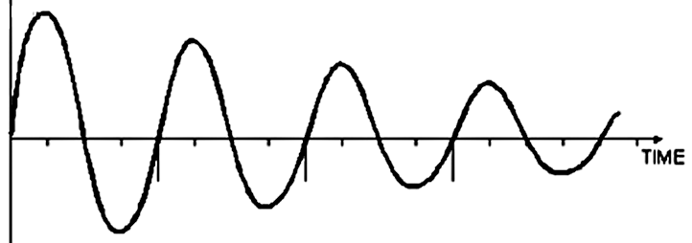
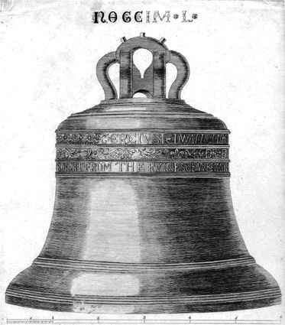
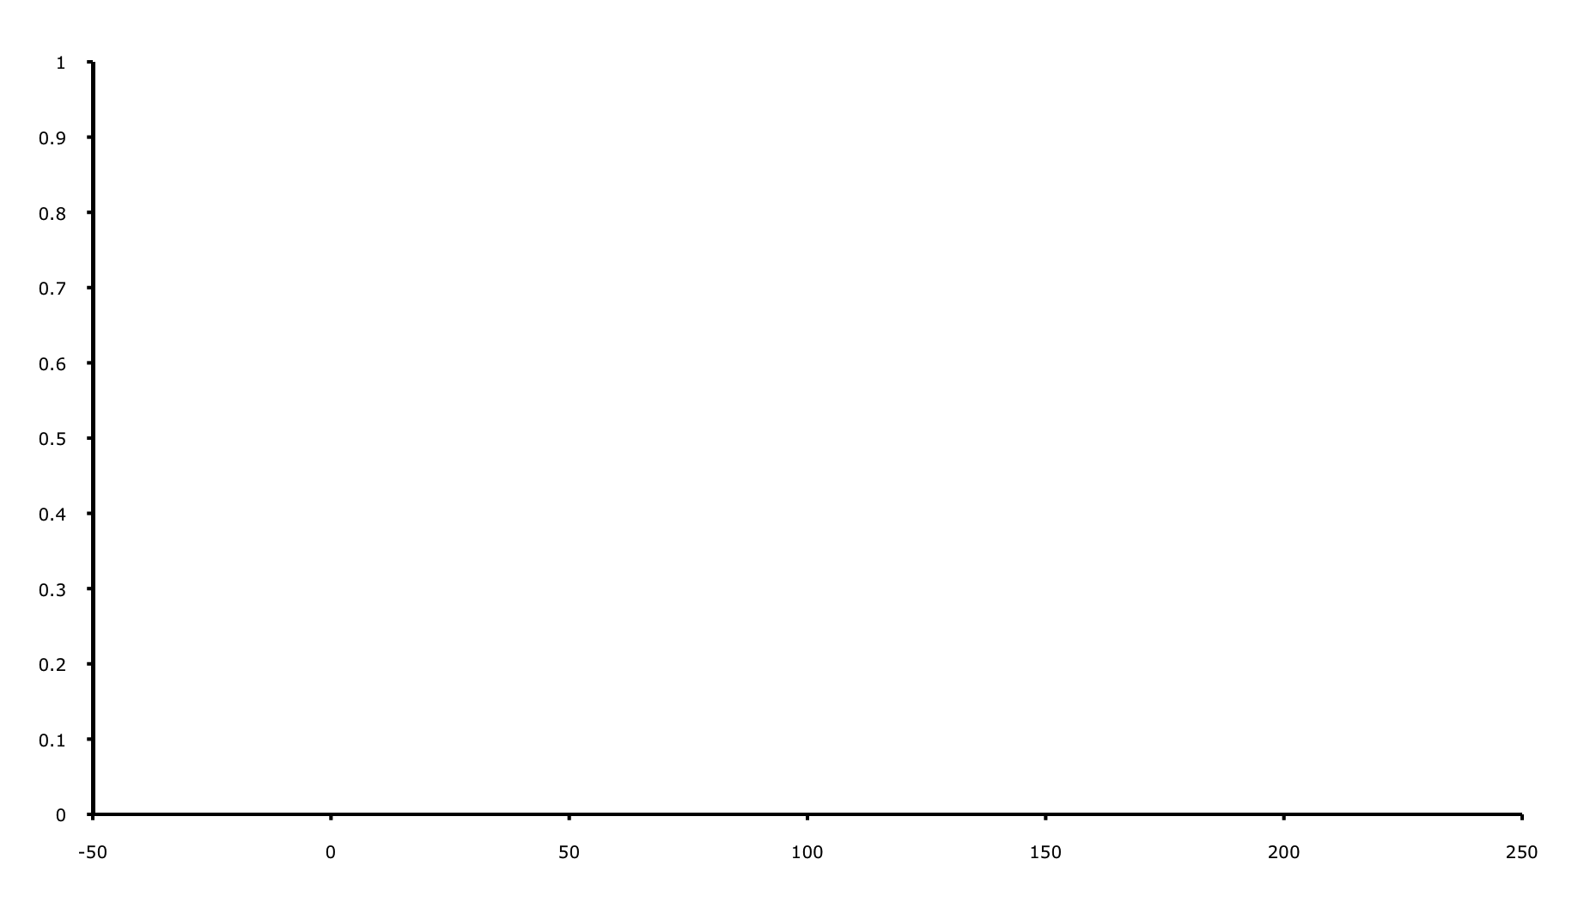
Impulse-Response Function (IRF)
The impulse-response function of a filter is the output of the filter when the input is a brief impulse
Filter Output
(Impulse Response Function)
Filter Input
(Impulse)
Notes:
© S. J. Luck. All Rights Reserved. May be used for nonprofit educational purposes if this copyright notice is included. Permission must be obtained from the copyright holder(s) for any other use.
Note: Bell image is in public domain (http://commons.wikimedia.org/wiki/File:Bell_great_tom_of_westminster.jpg)

Slide 25
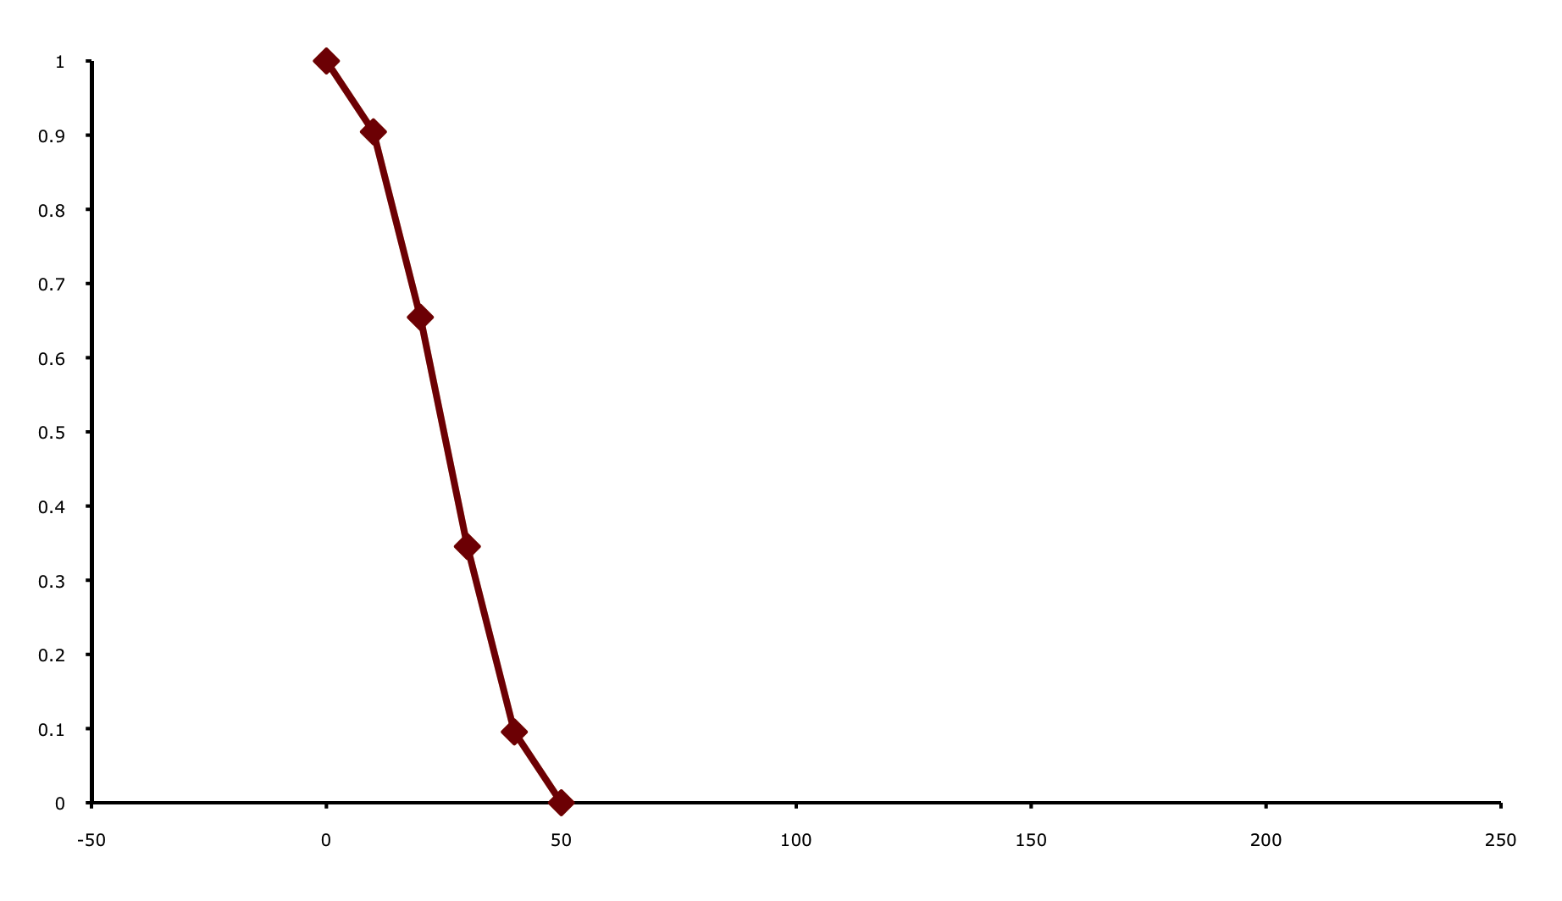
Impulse-Response Function (IRF)
The impulse-response function of a filter is the output of the filter when the input is a brief impulse
Filter Output
(Impulse Response Function)
Filter Input
(Impulse)
IRF amplitude is proportional to impulse amplitude
(IRF area = impulse height)
IRF duration is constant
Notes:
© S. J. Luck. All Rights Reserved. May be used for nonprofit educational purposes if this copyright notice is included. Permission must be obtained from the copyright holder(s) for any other use.

Slide 26
Impulse-Response Function (IRF)
Filter Input
(Continuous ERP Waveform)
Notes:
© S. J. Luck. All Rights Reserved. May be used for nonprofit educational purposes if this copyright notice is included. Permission must be obtained from the copyright holder(s) for any other use.

Slide 27
Impulse-Response Function (IRF)
One Impulse
Filter Input
(Series of Impulses)
Filter Output for This Impulse
(Scaled and Shifted IRF)
Each IRF is not actually as tall as the corresponding impulse
(IRF area = impulse height)
Notes:
© S. J. Luck. All Rights Reserved. May be used for nonprofit educational purposes if this copyright notice is included. Permission must be obtained from the copyright holder(s) for any other use.

Slide 28
Impulse-Response Function (IRF)
These scaled responses simply sum together
(This is what it means when we say that the filter is “linear”)
Each IRF is not actually as tall as the corresponding impulse
(IRF area = impulse height)
Notes:
© S. J. Luck. All Rights Reserved. May be used for nonprofit educational purposes if this copyright notice is included. Permission must be obtained from the copyright holder(s) for any other use.

Slide 29
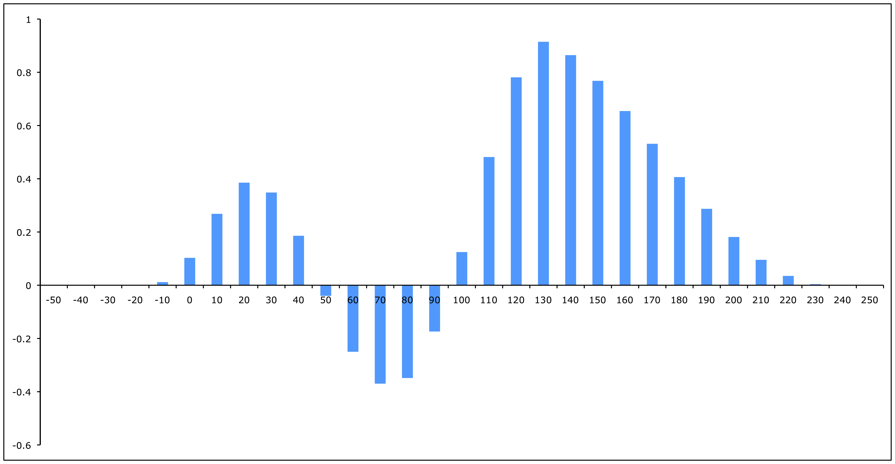
Impulse-Response Function (IRF)
With a digital filter, the IRF can extend both forward and backward in time
These scaled responses simply sum together
(This is what it means when we say that the filter is “linear”)
Each IRF is not actually as tall as the corresponding impulse
(IRF area = impulse height)
Notes:
© S. J. Luck. All Rights Reserved. May be used for nonprofit educational purposes if this copyright notice is included. Permission must be obtained from the copyright holder(s) for any other use.

Slide 30
IRF vs. Weighting Function
Weighting function = IRF reflected about time zero
IRF = effect of a given unfiltered value on the surrounding filtered values
Weighting function = effect of the surrounding unfiltered values on a given filtered value
Notes:
Adapted from Figure 5.5 in Luck, Steven J. (2005). An introduction to the Event-Related Potential Technique. Cambridge, MA: MIT Press.© MIT Press. This material may be used for nonprofit research and education purposes only, and it may not be reprinted or distributed in any form including print and electronic forms.
Other content: © S. J. Luck. All Rights Reserved. May be used for nonprofit educational purposes if this copyright notice is included. Permission must be obtained from the copyright holder(s) for any other use.

Slide 31
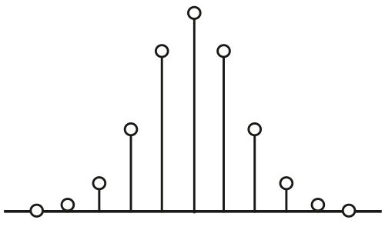
Relations Among Filter Methods
Relation between weighting and convolution:
Weighting- Each point in the filtered waveform is the average of the surrounding points, weighted by this function
Convolution- Replace each point in the unfiltered waveform with a scaled and shifted copy of this function
Relation to filtering in the frequency domain:
Convolution in the time domain =
Multiplication in the frequency domain
These three filtering methods are mathematically identical (same steps in a different order)
Notes:
Adapted from Figure 5.5 in Luck, Steven J. (2005). An introduction to the Event-Related Potential Technique. Cambridge, MA: MIT Press.© MIT Press. This material may be used for nonprofit research and education purposes only, and it may not be reprinted or distributed in any form including print and electronic forms.
Other content: © S. J. Luck. All Rights Reserved. May be used for nonprofit educational purposes if this copyright notice is included. Permission must be obtained from the copyright holder(s) for any other use.

Slide 32
Convolution
= impulse response function at time j
= weighting function at time -j
This is the “convolution” of IRF and ERP:
Relation to filtering in the frequency domain:
Convolution in the time domain =
Multiplication in the frequency domain
Notes:
© S. J. Luck. All Rights Reserved. May be used for nonprofit educational purposes if this copyright notice is included. Permission must be obtained from the copyright holder(s) for any other use.

Slide 33
Convolution & Multiplication
Notes:
Figure 5.6 from Luck, Steven J. (2005). An introduction to the Event-Related Potential Technique. Cambridge, MA: MIT Press.© MIT Press. This material may be used for nonprofit research and education purposes only, and it may not be reprinted or distributed in any form including print and electronic forms.
Other content: © S. J. Luck. All Rights Reserved. May be used for nonprofit educational purposes if this copyright notice is included. Permission must be obtained from the copyright holder(s) for any other use.

Slide 34
Convolution & Multiplication
Notes:
© S. J. Luck. All Rights Reserved. May be used for nonprofit educational purposes if this copyright notice is included. Permission must be obtained from the copyright holder(s) for any other use.

Slide 35
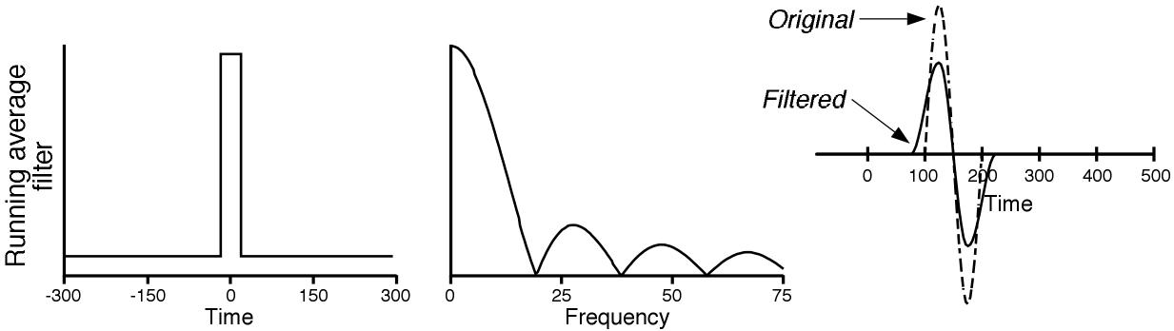
Examples of Low-Pass Filters
Impulse-Response Function
Frequency-Response Function
Original & Filtered Waveforms
Fourier Transform
Inverse Fourier Transform
Sudden transitions of impulse-response function lead to “side lobes” in frequency-response function
This can be used to have a zero point at a particular frequency (e.g., 60 Hz)
Notes:
Figure 5.9 from Luck, Steven J. (2005). An introduction to the Event-Related Potential Technique. Cambridge, MA: MIT Press.© MIT Press. This material may be used for nonprofit research and education purposes only, and it may not be reprinted or distributed in any form including print and electronic forms.
Other content: © S. J. Luck. All Rights Reserved. May be used for nonprofit educational purposes if this copyright notice is included. Permission must be obtained from the copyright holder(s) for any other use.

Slide 36
Examples of Low-Pass Filters
Impulse-Response Function
Frequency-Response Function
Original & Filtered Waveforms
Sudden transitions of impulse-response function lead to “side lobes” in frequency-response function
This can be used to have a zero point at a particular frequency
Notes:
Figure 5.9 from Luck, Steven J. (2005). An introduction to the Event-Related Potential Technique. Cambridge, MA: MIT Press.© MIT Press. This material may be used for nonprofit research and education purposes only, and it may not be reprinted or distributed in any form including print and electronic forms.
Other content: © S. J. Luck. All Rights Reserved. May be used for nonprofit educational purposes if this copyright notice is included. Permission must be obtained from the copyright holder(s) for any other use.

Slide 37
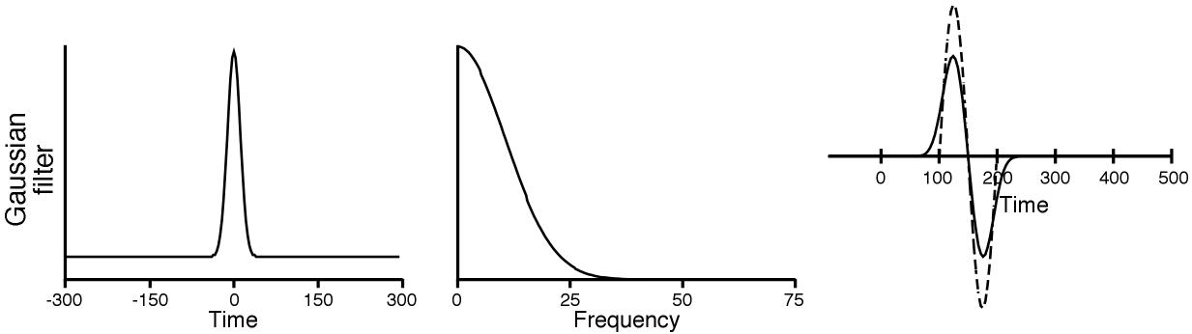
Examples of Low-Pass Filters
Impulse-Response Function
Frequency-Response Function
Original & Filtered Waveforms
Fourier Transform
Inverse Fourier Transform
Gradual changes in Gaussian impulse-response function lead to smooth, monotonic rolloff
Gaussian is optimal trade-off between precision in the time and frequency domains
Notes:
Figure 5.9 from Luck, Steven J. (2005). An introduction to the Event-Related Potential Technique. Cambridge, MA: MIT Press.© MIT Press. This material may be used for nonprofit research and education purposes only, and it may not be reprinted or distributed in any form including print and electronic forms.
Other content: © S. J. Luck. All Rights Reserved. May be used for nonprofit educational purposes if this copyright notice is included. Permission must be obtained from the copyright holder(s) for any other use.

Slide 38
Examples of Low-Pass Filters
Impulse-Response Function
Frequency-Response Function
Original & Filtered Waveforms
Fourier Transform
Inverse Fourier Transform
Gradual changes in Gaussian impulse-response function lead to smooth cutoff
Gaussian is optimal trade-off between precision in the time and frequency domains
Boxcar
Gaussian
Notes:
Figure 5.9 from Luck, Steven J. (2005). An introduction to the Event-Related Potential Technique. Cambridge, MA: MIT Press.© MIT Press. This material may be used for nonprofit research and education purposes only, and it may not be reprinted or distributed in any form including print and electronic forms.
Other content: © S. J. Luck. All Rights Reserved. May be used for nonprofit educational purposes if this copyright notice is included. Permission must be obtained from the copyright holder(s) for any other use.

Slide 39
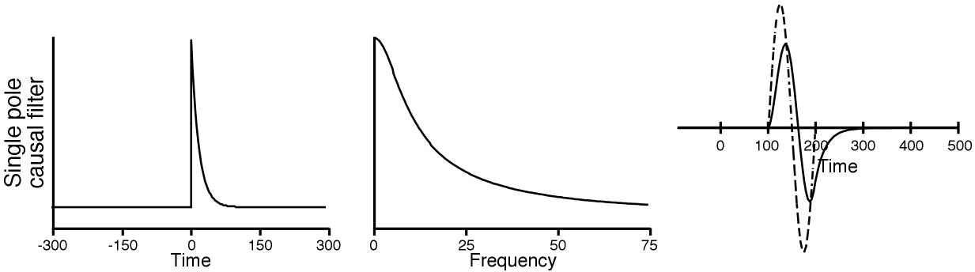
Examples of Low-Pass Filters
Impulse-Response Function
Frequency-Response Function
Original & Filtered Waveforms
This is a “causal” filter: It’s impulse-response function is zero prior to time zero. Most digital filters are “non-causal.”
Analog filters in EEG amplifiers are causal
Causal filters tend to increase ERP latencies (phase shift)
Notes:
Figure 5.9 from Luck, Steven J. (2005). An introduction to the Event-Related Potential Technique. Cambridge, MA: MIT Press.© MIT Press. This material may be used for nonprofit research and education purposes only, and it may not be reprinted or distributed in any form including print and electronic forms.
Other content: © S. J. Luck. All Rights Reserved. May be used for nonprofit educational purposes if this copyright notice is included. Permission must be obtained from the copyright holder(s) for any other use.

Slide 40
Examples of Low-Pass Filters
Impulse-Response Function
Frequency-Response Function
Original & Filtered Waveforms
This is a “causal” filter: It’s impulse-response function is zero prior to time zero. Most digital filters are “non-causal.”
Analog filters in EEG amplifiers are causal
Causal filters tend to increase ERP latencies (phase shift)
Notes:
Figure 5.9 from Luck, Steven J. (2005). An introduction to the Event-Related Potential Technique. Cambridge, MA: MIT Press.© MIT Press. This material may be used for nonprofit research and education purposes only, and it may not be reprinted or distributed in any form including print and electronic forms.
Other content: © S. J. Luck. All Rights Reserved. May be used for nonprofit educational purposes if this copyright notice is included. Permission must be obtained from the copyright holder(s) for any other use.

Slide 41
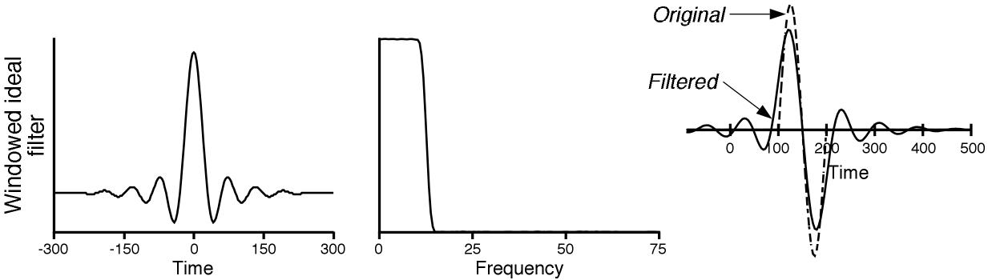
Examples of Low-Pass Filters
Impulse-Response Function
Frequency-Response Function
Original & Filtered Waveforms
Fourier Transform
Inverse Fourier Transform
This frequency-response function has a very steep rolloff but produces extreme time-domain distortions
Notes:
Figure 5.9 from Luck, Steven J. (2005). An introduction to the Event-Related Potential Technique. Cambridge, MA: MIT Press.© MIT Press. This material may be used for nonprofit research and education purposes only, and it may not be reprinted or distributed in any form including print and electronic forms.
Other content: © S. J. Luck. All Rights Reserved. May be used for nonprofit educational purposes if this copyright notice is included. Permission must be obtained from the copyright holder(s) for any other use.

Slide 42
Examples of Low-Pass Filters
Impulse-Response Function
Frequency-Response Function
Original & Filtered Waveforms
Fourier Transform
Inverse Fourier Transform
This frequency-response function has a very steep cut-off but produces a large time-domain distortions
Notes:
Figure 5.9 from Luck, Steven J. (2005). An introduction to the Event-Related Potential Technique. Cambridge, MA: MIT Press.© MIT Press. This material may be used for nonprofit research and education purposes only, and it may not be reprinted or distributed in any form including print and electronic forms.
Other content: © S. J. Luck. All Rights Reserved. May be used for nonprofit educational purposes if this copyright notice is included. Permission must be obtained from the copyright holder(s) for any other use.

Slide 43
Properties of Convolution
Associative & Distributive Properties:
Filtering before or after making difference wave:
Notes:
© S. J. Luck. All Rights Reserved. May be used for nonprofit educational purposes if this copyright notice is included. Permission must be obtained from the copyright holder(s) for any other use.

Slide 44
Filtering Twice
This gives you a wider impulse response function
What does this do to the frequency response function?
Answer: The two frequency response functions are multiplied by each other to create the combined frequency response function
Notes:
© S. J. Luck. All Rights Reserved. May be used for nonprofit educational purposes if this copyright notice is included. Permission must be obtained from the copyright holder(s) for any other use.

Slide 45
High-Pass Filters
High-pass filtering involves subtracting the low frequencies from the unfiltered ERP
Consequently, the IRF of a high-pass filter is an inverted version of a low-pass filter
Notes:
Figure 5.11 from Luck, Steven J. (2005). An introduction to the Event-Related Potential Technique. Cambridge, MA: MIT Press.© MIT Press. This material may be used for nonprofit research and education purposes only, and it may not be reprinted or distributed in any form including print and electronic forms.
Other content: © S. J. Luck. All Rights Reserved. May be used for nonprofit educational purposes if this copyright notice is included. Permission must be obtained from the copyright holder(s) for any other use.

Slide 46
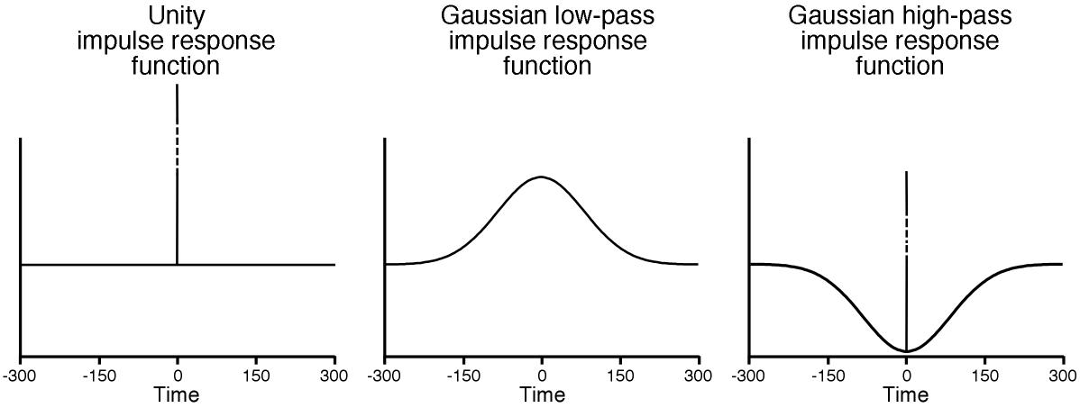
High-Pass Filters
Notes:
Figure 5.11 from Luck, Steven J. (2005). An introduction to the Event-Related Potential Technique. Cambridge, MA: MIT Press.© MIT Press. This material may be used for nonprofit research and education purposes only, and it may not be reprinted or distributed in any form including print and electronic forms.
Other content: © S. J. Luck. All Rights Reserved. May be used for nonprofit educational purposes if this copyright notice is included. Permission must be obtained from the copyright holder(s) for any other use.

Slide 47
High-Pass Filters
Notes:
Figure 5.11 from Luck, Steven J. (2005). An introduction to the Event-Related Potential Technique. Cambridge, MA: MIT Press.© MIT Press. This material may be used for nonprofit research and education purposes only, and it may not be reprinted or distributed in any form including print and electronic forms.
Other content: © S. J. Luck. All Rights Reserved. May be used for nonprofit educational purposes if this copyright notice is included. Permission must be obtained from the copyright holder(s) for any other use.

Slide 48
High-Pass Filter Artifacts
High-pass filters take an inverted version of the waveform and push it forward and backward in time
Notes:
Figure 5.11 from Luck, Steven J. (2005). An introduction to the Event-Related Potential Technique. Cambridge, MA: MIT Press.© MIT Press. This material may be used for nonprofit research and education purposes only, and it may not be reprinted or distributed in any form including print and electronic forms.
Other content: © S. J. Luck. All Rights Reserved. May be used for nonprofit educational purposes if this copyright notice is included. Permission must be obtained from the copyright holder(s) for any other use.

Slide 49
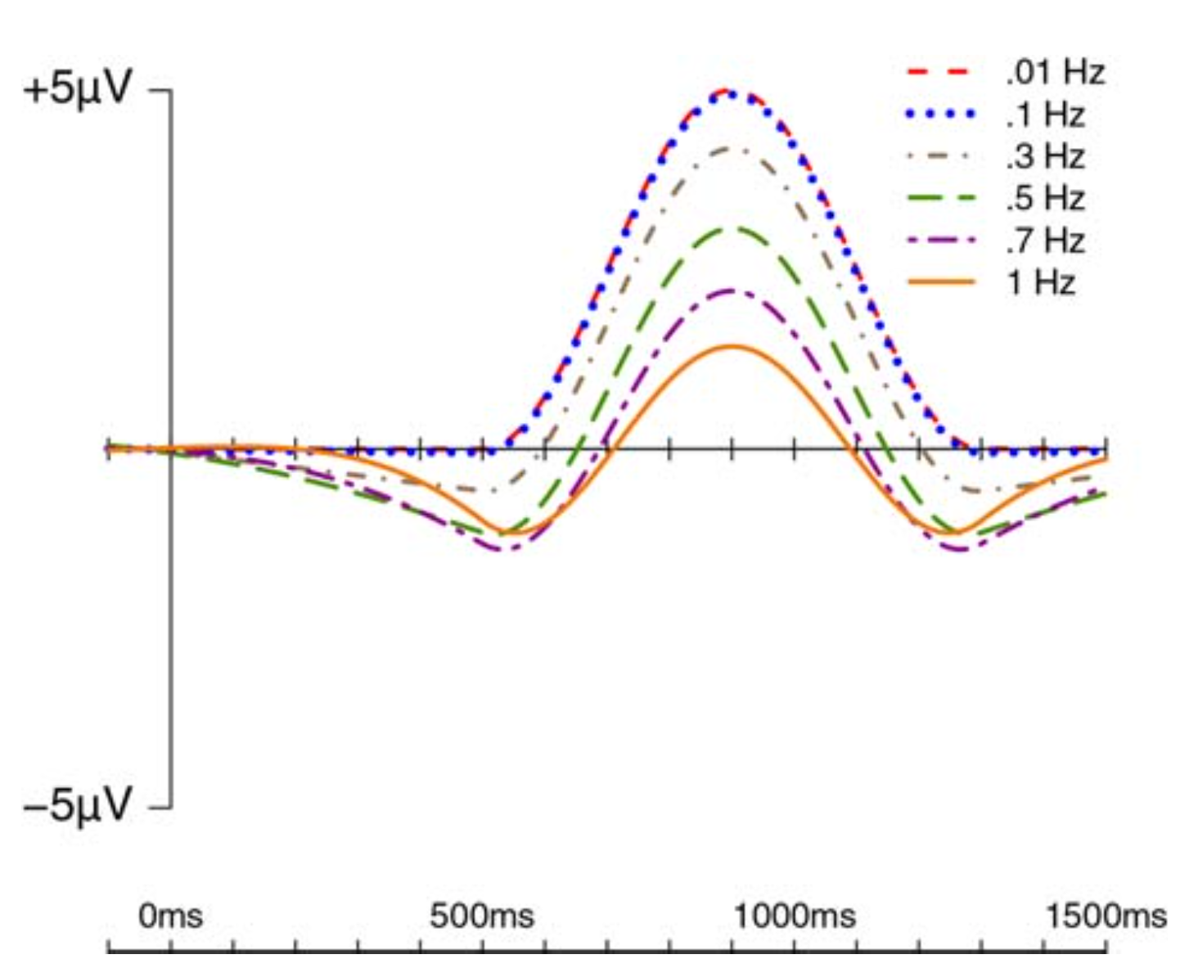
High-Pass Filter Artifacts
Simulated P600
Artifactual N400-like peak
High-pass filters take an inverted version of the waveform and push it forward and backward in time
Tanner, Morgan-Short, & Luck (2015)
Notes:
From Tanner, D., Morgan-Short, K., & Luck, S. J. (2015). How inappropriate high-pass filters can produce artifactual effects and incorrect conclusions in ERP studies of language and cognition. Psychophysiology, 52, 997-1009. © John Wiley and Sons. All rights reserved.

Slide 50
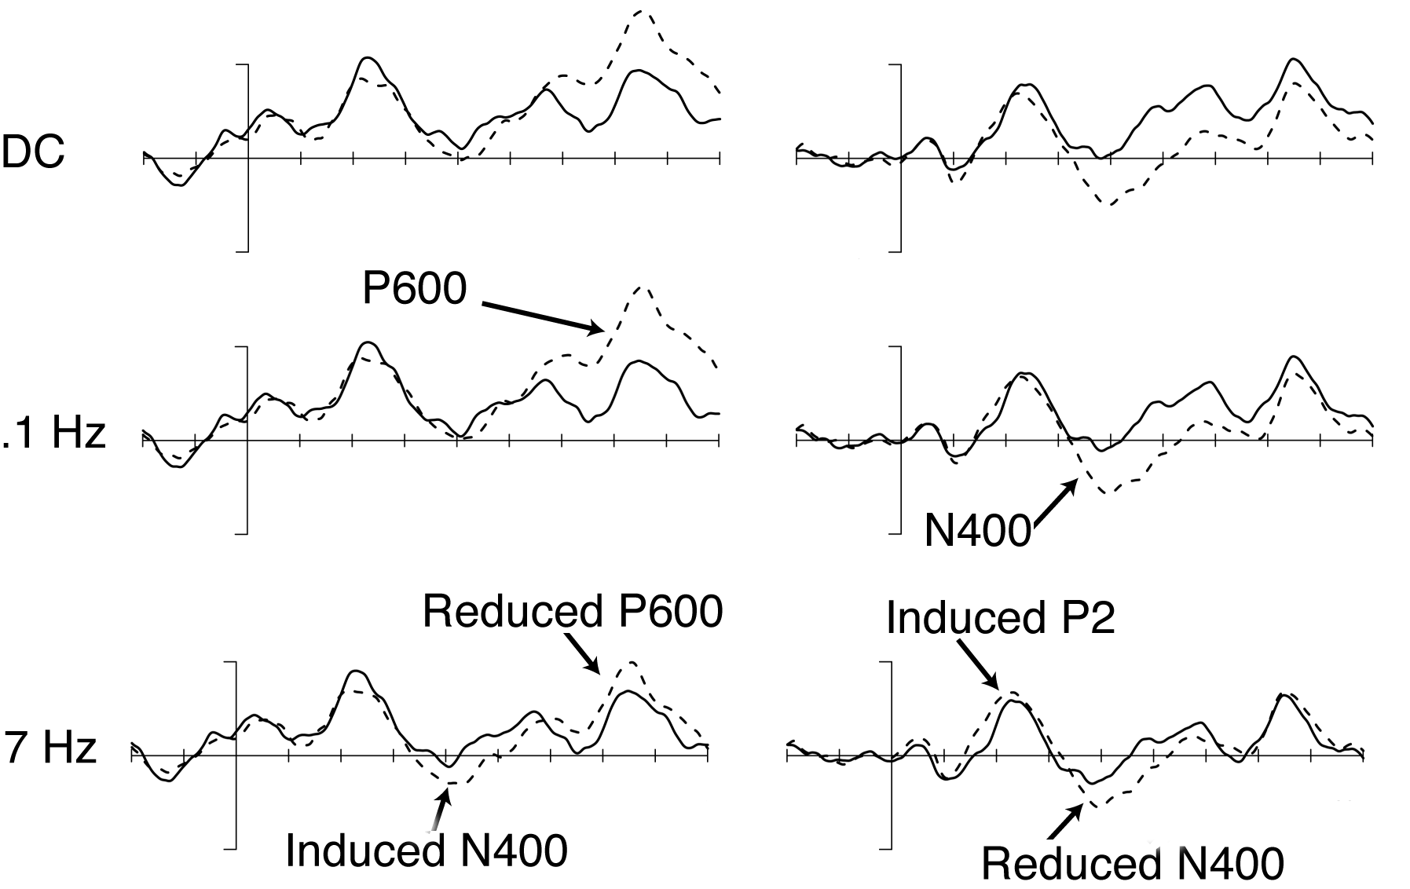
High-Pass Filter Artifacts
Syntactic Condition
“Many doctors claim/claims that insurance rates are too high”
Semantic Condition
“The rough part of the wood was sanded/swallowed to perfection”
Tanner, Morgan-Short, & Luck (2015)
Notes:
From Tanner, D., Morgan-Short, K., & Luck, S. J. (2015). How inappropriate high-pass filters can produce artifactual effects and incorrect conclusions in ERP studies of language and cognition. Psychophysiology, 52, 997-1009. © John Wiley and Sons. All rights reserved.

Slide 51
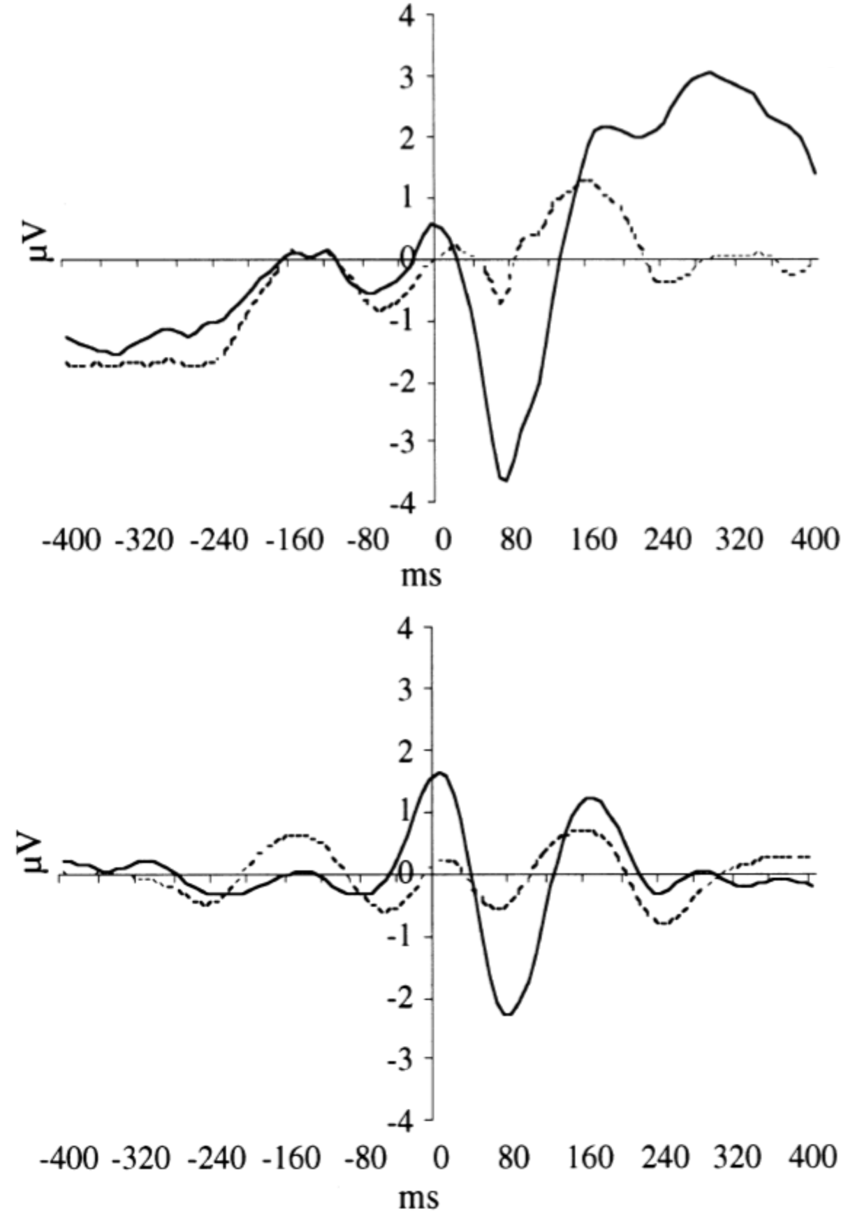
Are Filter Artifacts a Real Problem?
Response-Locked Correct and Error Trials
Unfiltered
Luu & Tucker (2001)
“By filtering out the large slow waves of the event-related potential, we found that the error-related negativity (Ne/ERN) arises from a midline frontal oscillation...”
Filtered
(Bandpass = 4-12 Hz)
Notes:
Left portion reprinted from Luu, P., & Tucker, D. M. (2001). Regulating action: Alternating activation of midline frontal and motor cortical networks. Clinical Neurophysiology, 112, 1295-1306, Copyright (2001), with permission from Elsevier
Other content: © S. J. Luck. All Rights Reserved. May be used for nonprofit educational purposes if this copyright notice is included. Permission must be obtained from the copyright holder(s) for any other use.

Slide 52
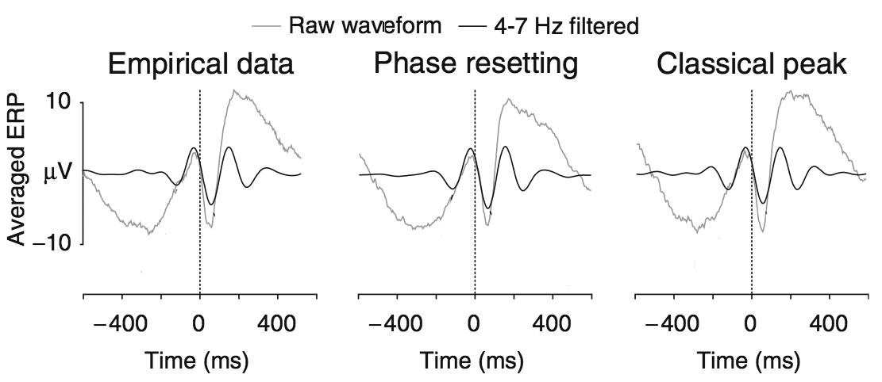
Are Filter Artifacts a Real Problem?
Extreme filtering produces an oscillating output, regardless of whether the input contains true oscillations
Yeung et al. (2007)
Notes:
Reprinted from Yeung, N., Bogacz, R., Holroyd, C. B., Nieuwenhuis, S., & Cohen, J. D. (2007). Theta phase resetting and the error-related negativity. Psychophysiology, 44, 39-49, Copyright (2007), used with permission of John Wiley and Sons.
Other content: © S. J. Luck. All Rights Reserved. May be used for nonprofit educational purposes if this copyright notice is included. Permission must be obtained from the copyright holder(s) for any other use.

Slide 53
Recommendations- Online Filtering
Filter as little as possible online
You can’t “unfilter” filtered data
Low-pass filter at 1/3–1/4 times the sampling rate
Notch filters are usually OK if needed
If you have 24+ bits
Record at DC
Record ~20 s of blank at beginning and end of each trial block
If you have <24 bits
High-pass filter cutoff between .01 and .1 Hz to avoid saturating the amplifier/ADC
.01 Hz for ideal conditions
0.1 Hz for less-than-ideal conditions
Notes:
© S. J. Luck. All Rights Reserved. May be used for nonprofit educational purposes if this copyright notice is included. Permission must be obtained from the copyright holder(s) for any other use.

Slide 54
Recommendations- Offline Filtering
High-pass filter cutoff at 0.01–0.1 Hz, 12 dB/octave, applied to the continuous EEG to avoid edge artifacts
Not usually necessary if you filtered out low frequencies during data acquisition, unless you want to go from .01 to .1
0.1 Hz usually gives best statistical power with minimal distortion
Do not use >0.1 Hz unless you really know what you’re doing
Low-pass filter cutoff at 20–40 Hz (12-24 dB/octave) to reduce noise during plotting or when measuring peaks
Typically applied after averaging (so you can look at unfiltered data)
Can be applied before artifact rejection/correction if it helps
Know your impulse-response function
You can find out by filtering a brief impulse
If in doubt, try filtering a fake waveform to see what kinds of distortion are produced by the filter
Apply low-pass filter to ERP when plotting or measuring nonlinear features (e.g., peaks), but not when measuring mean amplitude
Notes:
© S. J. Luck. All Rights Reserved. May be used for nonprofit educational purposes if this copyright notice is included. Permission must be obtained from the copyright holder(s) for any other use.

Slide 55
Infinite Impulse Response Filters
FIR
EEG
Filter
Filtered EEG
IIR
EEG
Filter
Filtered EEG
The good:
IIR can achieve a sharper rolloff with fewer data points
The bad:
Can be unstable (but typically OK for noncausal filters)
Harder to predict the effects by looking at IRF
Anything called “infinite” is scary
My experience with noncausal Butterworth IIR filters:
No worse than FIR filters in terms of filter artifacts
Better in terms of edge artifacts (shorter IRF)
Notes:
© S. J. Luck. All Rights Reserved. May be used for nonprofit educational purposes if this copyright notice is included. Permission must be obtained from the copyright holder(s) for any other use.

Slide 56
Overlap
Overlap can be modeled as a convolution of the ERP waveform and the distribution of SOAs
Notes:
Fig 4.5 of Luck, Steven J. (2005). An introduction to the Event-Related Potential Technique. Cambridge, MA: MIT Press.© MIT Press. This material may be used for nonprofit research and education purposes only, and it may not be reprinted or distributed in any form including print and electronic forms.

Slide 57
Notes:
Adapted from Figure 11.5 from Luck, S.J. (2014). An Introduction to the Event-Related Potential Technique, Second Edition. Cambridge, MA: MIT Press. © MIT Press.
This material may be used for nonprofit research and education purposes only, and it may not be reprinted or distributed in any form including print and electronic forms.

Slide 58
Stimulus Timing Jitter
Distribution of Stimulus Delays
Example: Stimulus appears 0, 10, or 20 ms after event code with even distribution
Waveform appears at 0, 10, or 20 ms with equal likelihood
Averaging these together is equal to replacing each point in the distribution of delays with a scaled and shifted version of the ERP waveform
The result is slightly low-pass filtered and shifted to the right in time
What is frequency response of filter produced by jitter?
Notes:
© S. J. Luck. All Rights Reserved. May be used for nonprofit educational purposes if this copyright notice is included. Permission must be obtained from the copyright holder(s) for any other use.

